Slide 1
PERSONAL FINANCE TRACKER
ASSIGN BY :
AMAN SHARMA
PRESENTED BY :
ADARSH KUSHWAH
ANUKRITI GUPTA
SHREYA SUKLA

Slide 2
Introduction to Personal Finance Tracker :
A personal finance tracker is a tool designed to help individuals manage their money by recording and analyzing their income, expenses, savings, and investments. In today's fast-paced world, it can be easy to lose track of where your money is going. A finance tracker offers a clear, organized way to see your financial situation in one place, helping you make informed decisions about how to spend, save, and plan for the future.

Slide 3
Expense Categorization
01
Income Tracking
A finance tracker helps you keep a record of all your sources of income, whether it's from your salary, freelance work, investments, or any other source.
02
Bill Payment Reminders
Many finance trackers send you reminders about upcoming bill payments, helping you avoid late fees and manage your cash flow.
03
Savings Goals
You can set specific savings goals, such as a an emergency fund or saving for a vacation.

Slide 4

Expense Categorization:
"Track your spending without the hassle."
Categories like groceries, entertainment, bills, you see where you can cut back.
Savings Goals:
"Reach your financial dreams, whether it's buying a home or saving for a vacation."
Set specific savings targets and track your progress automatically.
Bill Payment Reminders:
"Never miss a bill again!"
Receive timely reminders about due dates to avoid late fees.
Debt Management:
"Pay off debt faster with a clear plan."
Track your debts, interest rates, and payment progress in one place.
Reports and Analytics:
"Get a snapshot of your financial health in seconds."
Clear reports help you analyze your income, expenses, savings, and debt.
Highlight Key Features That Make a Difference:
d

Slide 5


On global uses
Global Financial Literacy
Problem: A large portion of the global population struggles with financial literacy, leading to poor financial decisions, debt, and low savings.
Impact: With widespread access to these tools, individuals can develop stronger financial habits, which can contribute to better financial health at a global level.
Financial Inclusion and Access
Problem: In many parts of the world, especially in developing countries, people lack access to traditional banking and financial services.
Solution: Personal finance trackers are often available through mobile apps, making it possible for individuals in remote or underserved areas to access financial management tools with just a smartphone and internet connection.

Slide 6
SCOPE OF PERSONAL FINANCE TRACKER
Emergency Funds: Setting aside money for unforeseen expenses.
Retirement Savings: Monitoring retirement accounts.
Specific Savings Goals: Saving for a vacation, a car, or a home.
Fraud Detection Alerts: Notifying users of unusual spending behavior or potential fraud.
Data Encryption: Ensuring sensitive financial information is protected from cyber threats.
D
ALLPPT Layout
ALLPPT Layout
ALLPPT Layout
ALLPPT Layout
D
Automated Budget Adjustments: AI suggests adjustments to budgets based on spending patterns.
Predictive Analytics: AI can predict future expenses and help users plan ahead for large purchases or events.
Multiple Currencies: Converting and tracking transactions in different currencies.
International Taxes: Assisting with compliance for individuals working in multiple countries.

Slide 7
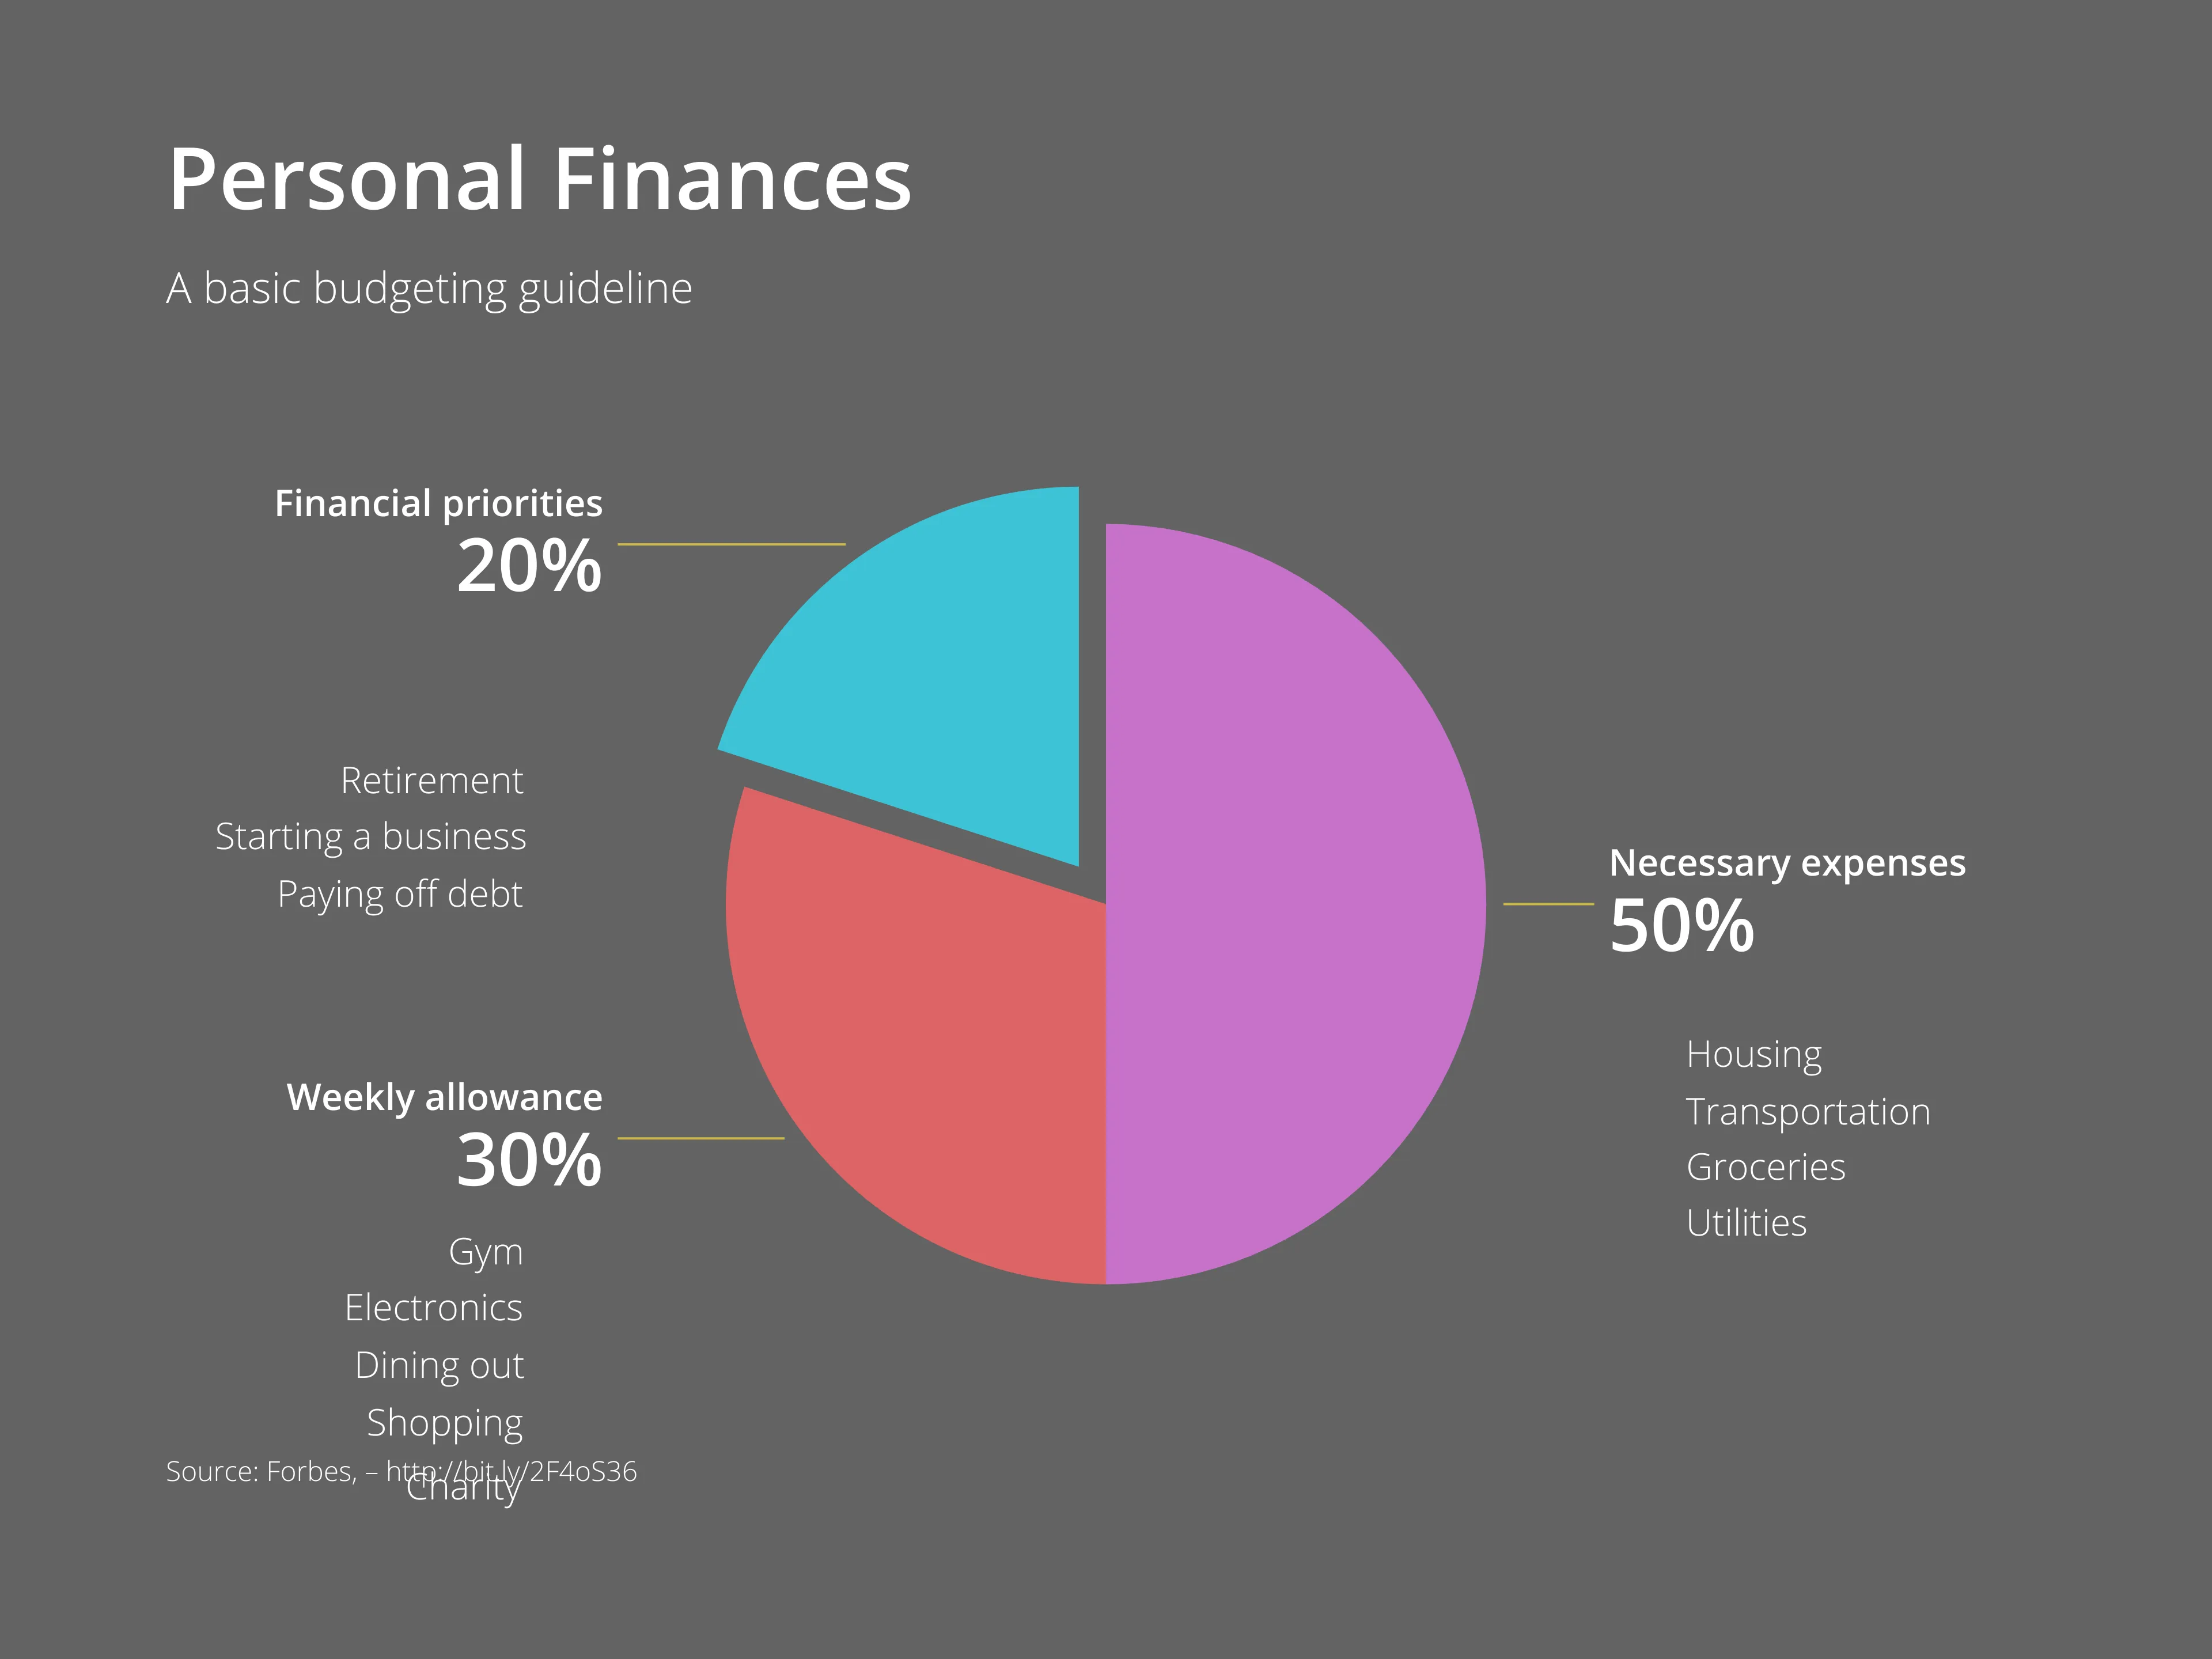
GRAPH REPRESENTATION

Slide 8
THANK YOU
Insert the Subtitle of Your Presentation

